Slide 1
AGRICULTURAL ENGINEERING
Bachelor of Engineering in Agricultural Engineering (3 Years)
Bachelor of Engineering (Hons) in Agricultural Engineering (4 Years)
Notes:
Balance of time between the Mountbellew and Dublin road campus
Importance of Work placements , national and international opportunities
Industry focus
List companies

Slide 2
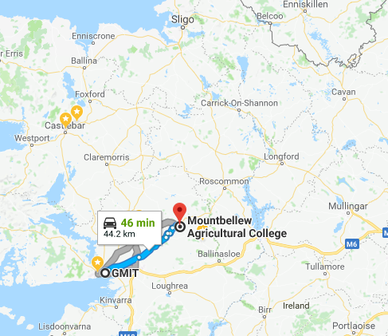
AGRICULTURAL ENGINEERING
Mountbellew Agricultural College & Dublin Road Campus
Notes:
Balance of time between the Mountbellew and Dublin road campus
Importance of Work placements , national and international opportunities
Industry focus
List companies

Slide 3
AGRICULTURAL ENGINEERING
Work Placement
Notes:
Balance of time between the Mountbellew and Dublin road campus
Importance of Work placements , national and international opportunities
Industry focus
List companies

Slide 4
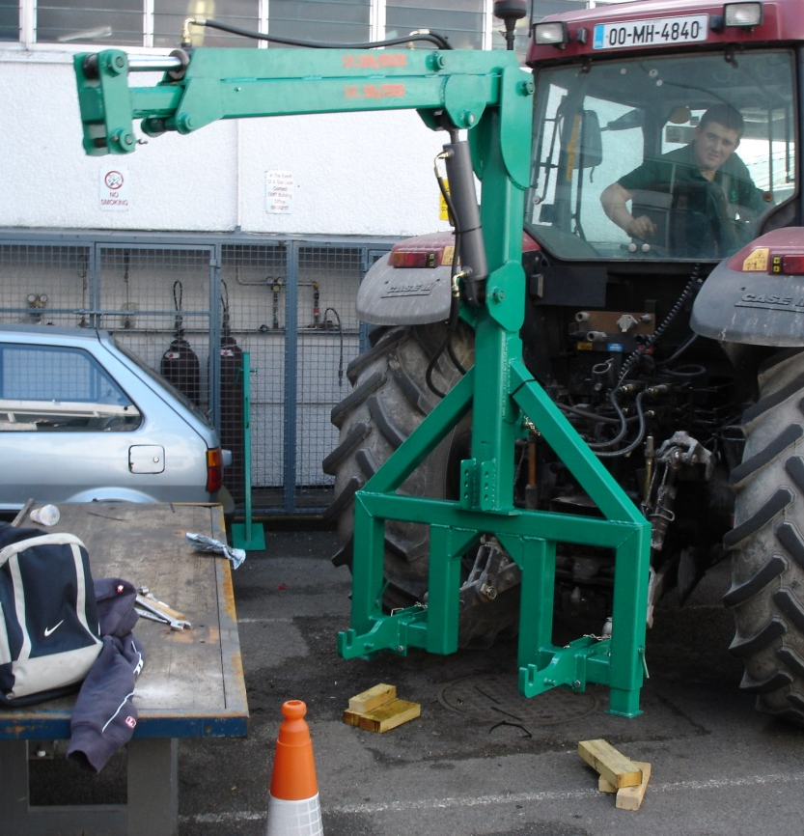
AGRICULTURAL ENGINEERING
Major Project
Notes:
Balance of time between the Mountbellew and Dublin road campus
Importance of Work placements , national and international opportunities
Industry focus
List companies

Slide 5
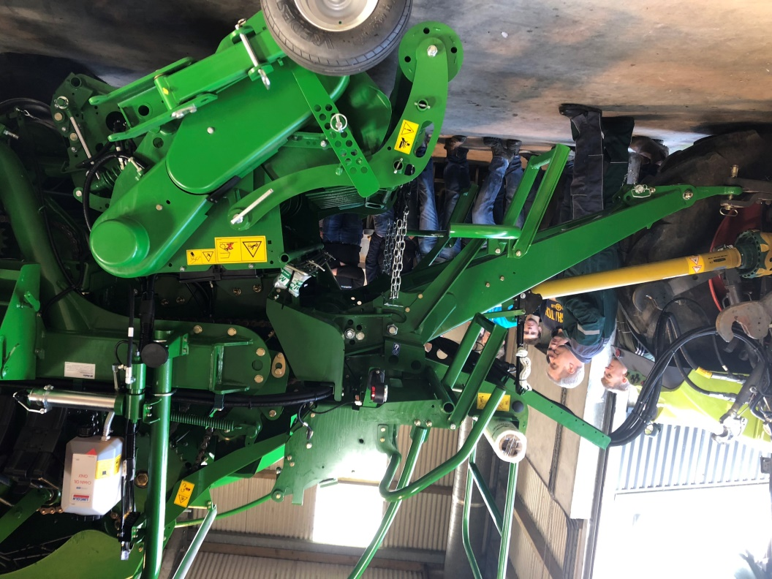
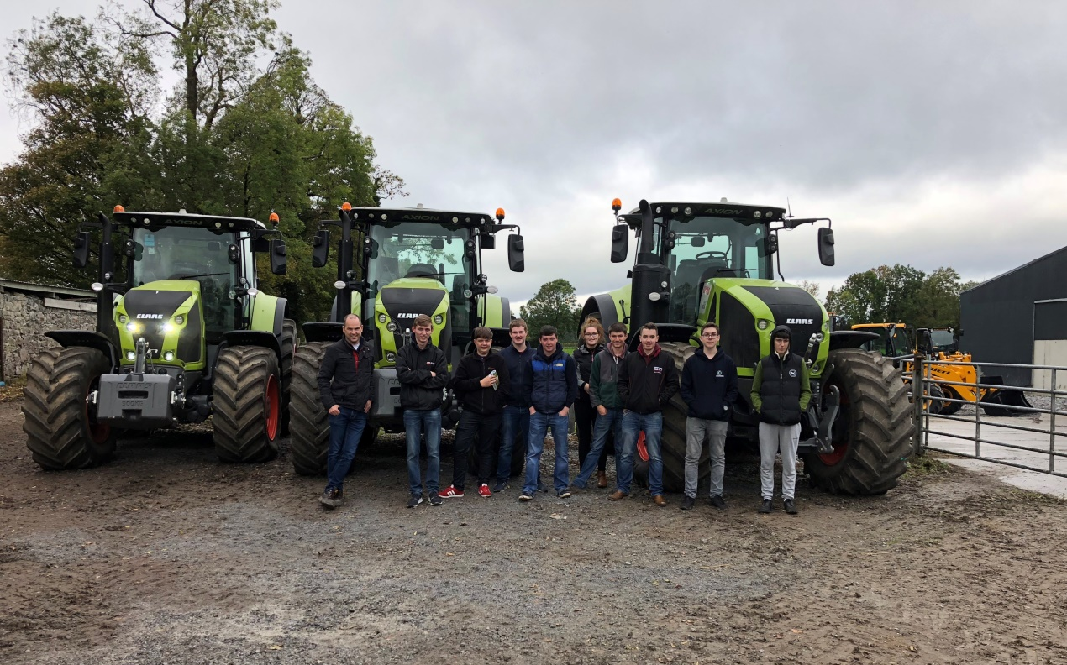
AGRICULTURAL ENGINEERING
Field Trips
Notes:
Balance of time between the Mountbellew and Dublin road campus
Importance of Work placements , national and international opportunities
Industry focus
List companies

Slide 6
AGRICULTURAL ENGINEERING
Engineers Ireland
New
Young Trained Farmer Status
“Greencert”
Notes:
Balance of time between the Mountbellew and Dublin road campus
Importance of Work placements , national and international opportunities
Industry focus
List companies

Slide 7
AGRICULTURAL ENGINEERING
We look forward to seeing you in September 2021
Notes:
Balance of time between the Mountbellew and Dublin road campus
Importance of Work placements , national and international opportunities
Industry focus
List companies

